Slide 1
Speech Emotion Recognition
Presented by:
Jasmin Joy - 16335976
Hemanth Reddy Kolli - 14411094
Keerthi Reddy Chinthala - 16338662
Sushmitha Reddy Pollapalli - 16336844

Slide 2
Objective
To Build a model to recognize emotions from speech.
Data used as input for this model is RAVDESS (Ryerson Audio-Visual Database of Emotional Speech and Song dataset), created by Steven Livingstone and Frank Russo of Ryerson University.
The model has been trained to classify seven different emotions( Anger, Calm, Disgust, Fearful, Happy, Sad, Surprised).
Model is implemented using various classification algorithms like KNN, SVM, Naïve Bayes, Logistic Regression, Decision Trees, Random Forest, MLCC etc.

Slide 3
Introduction & Data Collection
Human speech contains several features that the listener interprets to unpack the rich information transmitted by the speaker.
The speaker also inadvertently shares tone, energy, speed, and other acoustic properties, which helps capture the subtext or intention and literal words.
We have used the RAVDESS dataset (Ryerson Audio-Visual Database of Emotional Speech and Song dataset), created by Steven Livingstone and Frank Russo of Ryerson University.
We have use the audio-only speech portion of the RAVDESS dataset, ~200MB.
Audio is sourced from 24 actors (12 male, 12 female) repeating two sentences with a variety of emotions and intensity.
We get 1440 speech files (24 actors * 60 recordings per actor).
Notes:
Livingstone SR, Russo FA (2018) The Ryerson Audio-Visual Database of Emotional Speech and Song (RAVDESS): A dynamic, multimodal set of facial and vocal expressions in North American English. PLoS ONE 13(5): e0196391. https://doi.org/10.1371/journal.pone.0196391.

Slide 4
Feature extraction
Feature extraction refers to the process of transforming raw data into numerical features that can be processed while preserving the information in the original data set.
In this project we have used Librosa library of python to extract the features mel spectrorgams, chromagrams, and MFCC.
librosa is a python library for analyzing audio and music. It has a flatter package layout, standardizes interfaces and names, backwards compatibility, modular functions, and readable code.
Chromagram: Will produce 12 features; One for each of 12 pitch classes
Mel Spectrogram: Will produce 128 features
MFCC: Mel Frequency Cepstral Coefficient, represents the short-term power spectrum of a sound , Will produce 40 MFCCs; We have set the number of coefficients to return at n_mfcc=40.
Acoustic features extracted from the audio for classification are MFCC, Croma and Mel

Slide 5
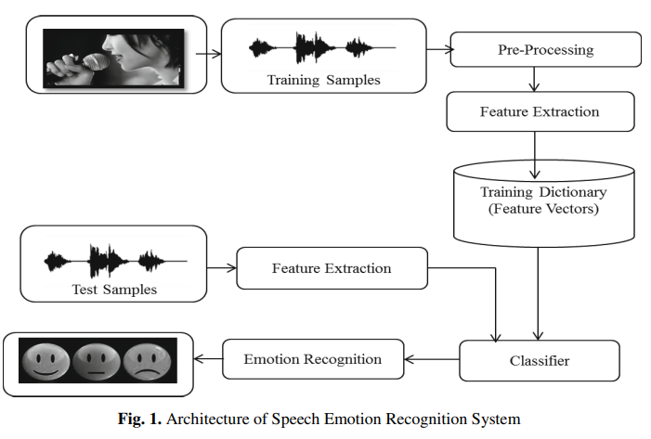
Architecture
Notes:
Kamble, Vaibhav & Deshmukh, Ratnadeep & Karwankar, Anil & Ratnaparkhe, Varsha & Annadate, Suresh. (2014). Emotion Recognition for Instantaneous Marathi Spoken Words. 10.1007/978-3-319-12012-6_37.

Slide 6

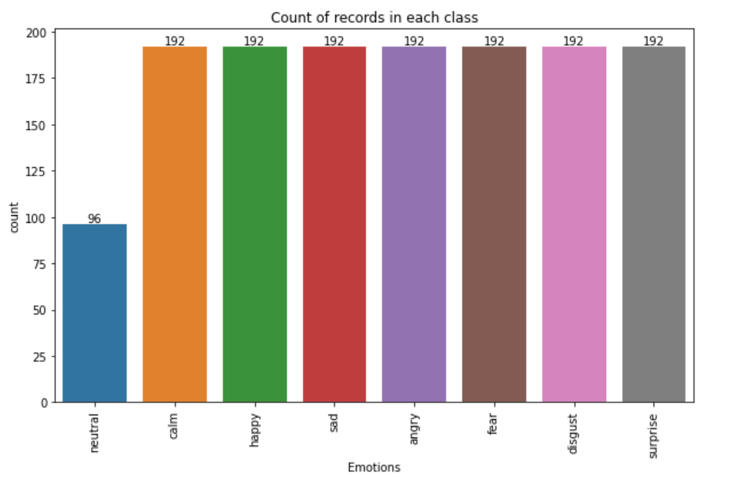
Implementation
Understanding the data
Count of records based on emotions

Slide 7
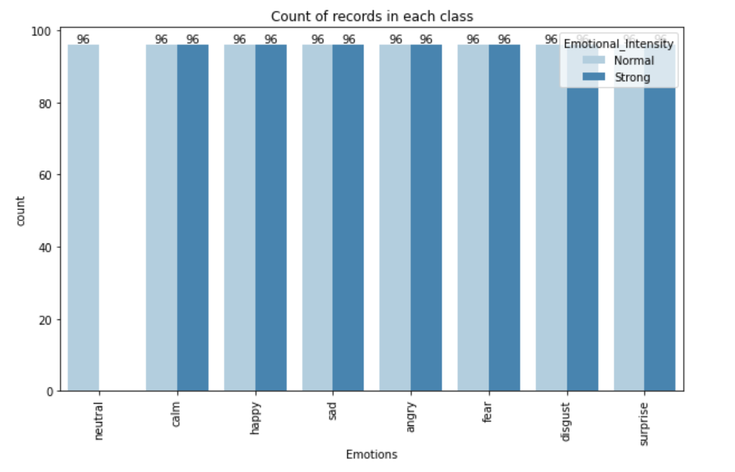
Implementation
Count of records based on emotional intensity
Normal
Strong

Slide 8
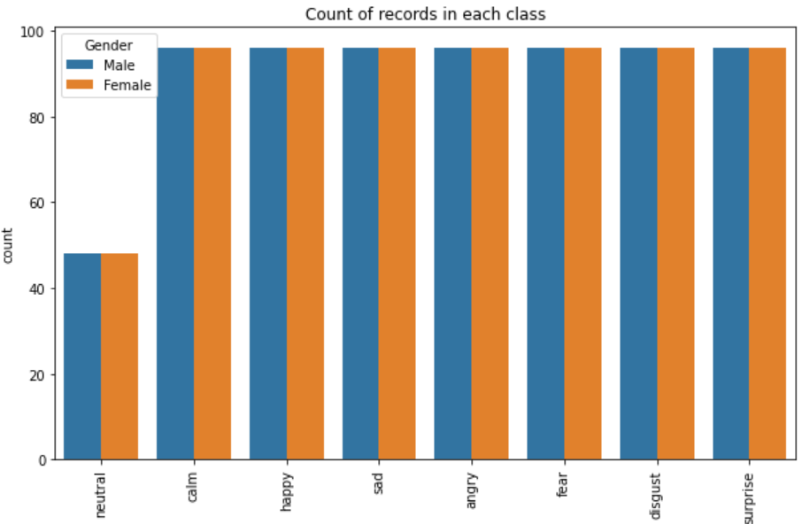
Count of records based on gender (male , female)

Slide 9
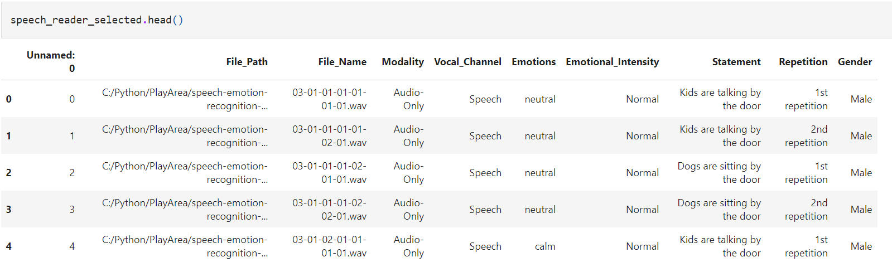
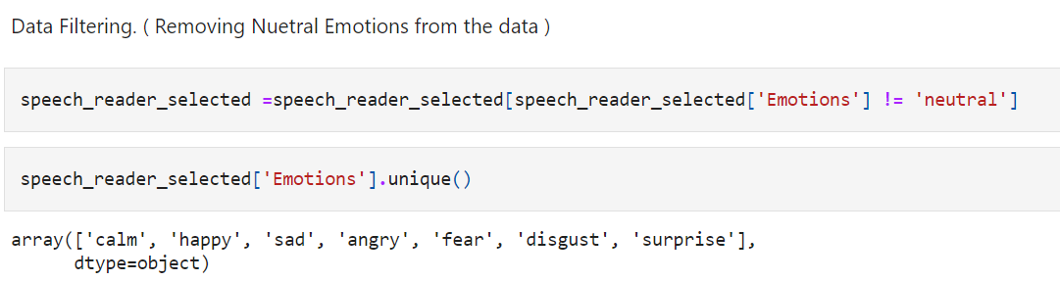
Implementation

Slide 10
Classification
In this project we have compared the performance of multiple machine learning models on the extracted features.
We have also compared the accuracies after applying various scaling methods like min-max scaler and standard scaler.
We have taken a model that performed the best and have checked the confusion matrix of that model to see how well it has performed.

Slide 11
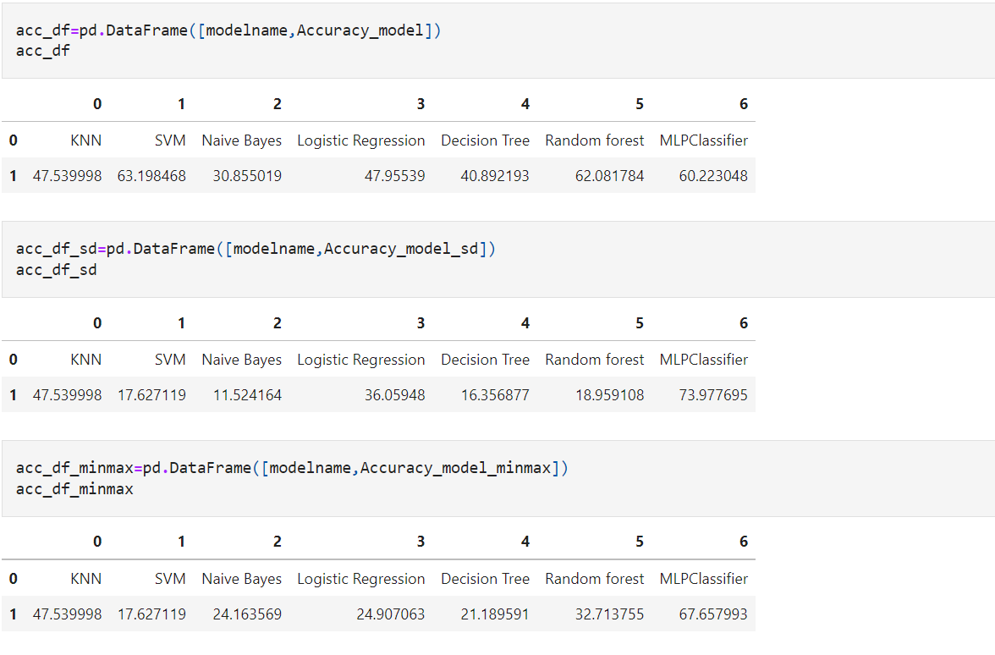
Results

Slide 12
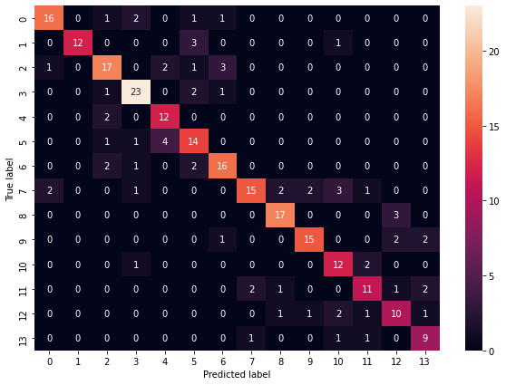
Classification Matrix for MLP Classifier

Slide 13
Applications where it can be used:
Voice assistance
Business Marketing
Call Centers
Tele Marketing etc.

